Slide 1
LSTM

Slide 2
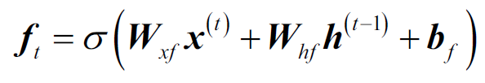
Forget gate
Source: https://towardsdatascience.com/illustrated-guide-to-lstms-and-gru-s-a-step-by-step-explanation-44e9eb85bf21

Slide 3
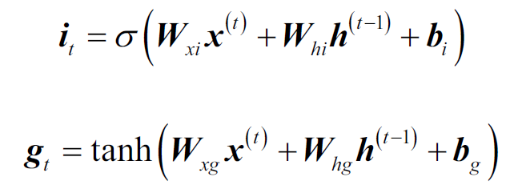
Input gate
Source: https://towardsdatascience.com/illustrated-guide-to-lstms-and-gru-s-a-step-by-step-explanation-44e9eb85bf21

Slide 4

Cell State
Source: https://towardsdatascience.com/illustrated-guide-to-lstms-and-gru-s-a-step-by-step-explanation-44e9eb85bf21

Slide 5

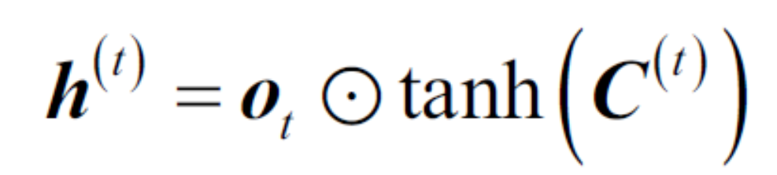
Output Gate
Source: https://towardsdatascience.com/illustrated-guide-to-lstms-and-gru-s-a-step-by-step-explanation-44e9eb85bf21

Slide 6
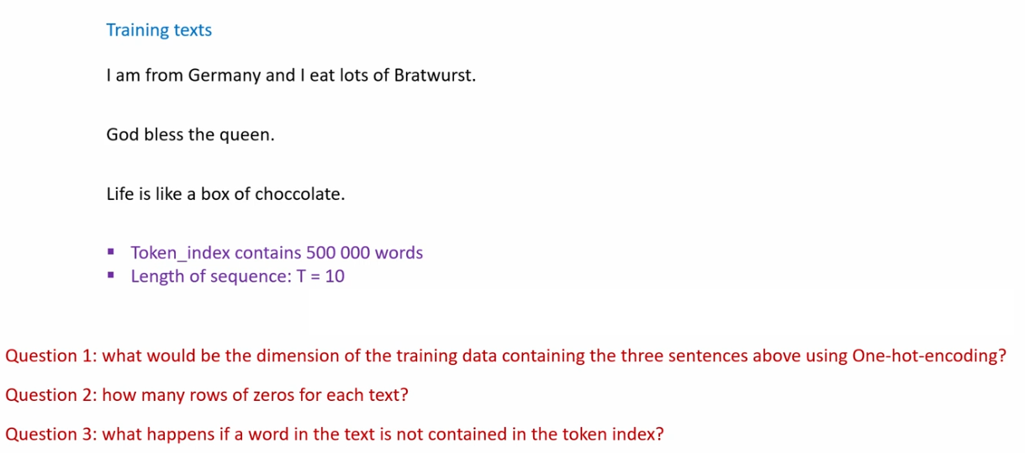

Slide 9


Slide 10
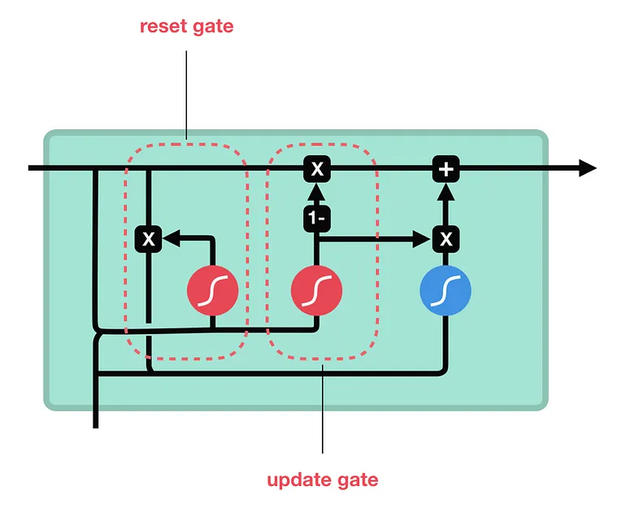
Gated Recurrent Units - GRU

Slide 11
CNN - RNN
Video Analysis and Processing
Time-Series Forecasting with Spatial Components
Audio and Speech Processing.
Medical Image Analysis
Sign Language Interpretation.

Slide 12
Class Activity - "Exploring Applications of CNN-RNN Architectures"
Objective: To explore and present the real-world applications of combined CNN-RNN models in various domains.
Make groups, focusing on one of the following topics:
Video Analysis and Processing
Time-Series Forecasting
Audio and Speech Processing
Medical Image Analysis
Sign Language Interpretation
Each group focusses and discusses the
Application
How the CNN-RNN can be applied
Challenges
Learning Goals:
Gain insights into practical uses of CNN-RNN models.
Encourage critical thinking about the advantages and limitations of deep learning applications.

Slide 13
CNN - RNN
Video Analysis and Processing
Application: Emotion Recognition in Videos
Time-Series Forecasting with Spatial Components
Application: Environmental Event Detection
Audio and Speech Processing
Application: Speech Emotion Recognition
Medical Image Analysis
Application: Disease Progression Analysis
Sign Language Interpretation
Application: Sign Language to Text Conversion

Slide 14
Gated Recurrent Units - GRU
Check CNN-RNN_GRU.ipynb

Slide 15
Training RNNs on time series data
We have ~420551 timesteps, each with 14 features.
Generator Parameters:
lookback=1440 (minutes): We look back 1440 timesteps for each sample (24 (hours) * 60 (minutes) * 10 (days) =1440 ).
delay=144: We are predicting the value 144 (one day) timesteps ahead (24 (hours) * 60 (minutes) =144).
batch_size=128: Each batch contains 128 samples.
min_index=0, max_index=200000: We're using the first first 200000 timesteps for training.
The sequence length is10
step=6: The period, in timesteps, at which we sample data. We sample every 6th timestep within our lookback window.
Each sample in a batch consists of 240 time steps. This is calculated as lookback // step = 1440 // 6 = 240.
Batch Examples:
First Batch:
Sample 1:
Input: range(0, 1440, 6) out of 240 indices: [0, 6, 12, 18, 24, 30, 36, 42, 48, 54]
Target: Feature from timestep 1584
Sample 1:
Input: range(1, 1441, 6) out of 240 indices: [1, 7, 13, 19, 25, 31, 37, 43, 49, 55]
Target: Feature from timestep 1585
Sample 3:
Input: range(2, 1442, 6) Features from outof 240 indices: [2, 8, 14, 20, 26, 32, 38, 44, 50, 56]
Target: Feature from timestep 1586
…
Sample 128:
Input: range (127, 1567, 6) Features from timesteps [127, 133, 139, 145, 151, 157, 163, 169, 175, 181]
Target: Feature from timestep 1711.

